Slide 1
STUDENT SUCCESS: A BEHAVIORAL INTERVENTION APPROACH FOR COMMUNITY COLLEGES
Dr. C. Fairley Pollock
Dr. Phil Weast

Slide 2
Theories of Student Retention and Success Influencing our Current Model
Kegan- Evolving Self Theory
Astin- Student Involvement Theory
Tinto- Theory of Student Departure, Theory of Student Involvement
Pascarella & Terenzini- How College Affects Students and Student Engagement
Kuh- Student Engagement

Slide 3
Student Success includes:
Academic Achievement & High Expectations
Student Engagement & Satisfaction
Acquisition of current knowledge & competencies
Requires student participation in activities proven to encourage success
Culture of assessment and improvement
Early alert systems with safety nets
Collaborative

Slide 4
Timeline of Development
January 2005 and February 2008- CCSSE administered (Community College Survey of Student Engagement)
March 20, 2009- John N. Garner visits SCC
October 1, 2009- Title III- Student Persistence and Success
September 2010- SENSE administered(Survey of Entering Student Engagment)

Slide 5
November 5, 2010- Kay McClenny visits SCC
November 2010- Revision of the Student Success Committee
November 2010- RATS (Retention Action Teams) formed
August 2011- Retention Alert Initiated
October 2011- Academic Impressions Conference/Training

Slide 6
Spring 2011- Scott Lewis NaBita, NCHERM
Fall 2011- RATs refined
August 2011- Student Assessment Team formed
September 2012- Maxient Introduced, Retention Alert retired

Slide 7
Success Programs & Services now in Place
New Student Orientation Required
College Success course Required of all new students
Regular surveys including CCSSEE & SENSE
Assess all new students’ readiness for online learning – Smarter Measure
Pre-Admissions Counselor contacts all new applicants
Placement Test Prep Required
SAT meets regularly; revising procedures based on best practices.
Ongoing: Assessment/Data – Policy Reviews –

Slide 8
Beginning of the Student Assessment, Behavioral Intervention Team at SCC
SAT formation
SAT mission
Maxient

Slide 9
Behavioral Intervention Protocol
Faculty/Staff Reporting Form
Student Reporting Form

Slide 10
Routing Protocol
Academic Concerns Behavioral Concerns
Academic Engagement Student Services
Coordinator/ Academic Dean Dean or Coordinator
Student Assessment Team
Code of Conduct Student Services
Violations Dean or Coordinator

Slide 11
Behavioral Intervention and SAT Protocols and Procedures
Report / Routing / Intervention
Routed to SAT/ Risk Level / Assessments/ Intervention

Slide 12
Behavioral Intervention and SAT Protocols and Procedures
Tools: NaBITA Threat Assessment Tool
SIVRA-35: Structured Interview for Violence Risk Assessment
Training/Resources
National Center for Higher Education Risk Management - http://ncherm.org/
National Behavioral Intervention Team Association - http://nabita.org/

Slide 13
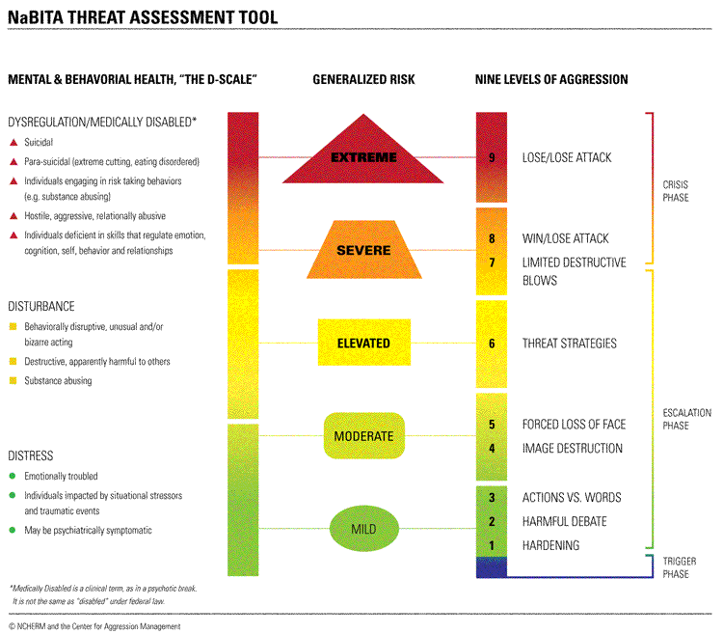

Slide 14
Results
Overall
2011-2014
Not retained
15.6%
Retained
84.4%

Slide 15
Results
2011-2012
Not retained
46.7%
Retained
53.3%

Slide 16
Results
2012-2013
Not retained
30.8%
Retained
69.2%

Slide 17
Results
2013-2014
Not retained
17.4%
Retained
82.6%

Slide 18
Thank You

