Slide 1
Successfully Supporting Student Veterans
March 7, 2014

Slide 2
Session goals
Present best practices for supporting student veterans
Describe some of the services provided at ATC
Encourage more colleges to help veterans transition to and succeed in college
Notes:
RW: F#1, 2, 3
LM: #4 and 5

Slide 3
Why focus on student veterans?
Members of our communities
Increased number
Financial win-win
Returning the investment
Support their transition
Notes:
RW: F#1, 2, 3
LM: #4 and 5

Slide 4
Eight keys to best practices
Support from campus leadership
Collaboration
Centralized efforts
Culture of connectedness
Faculty/staff development
Early alert system
Uniform data tools
Systems that ensure sustainability
Source: “The Success of Veterans on America’s Campus: A Key Mission”
Notes:
VB

Slide 5
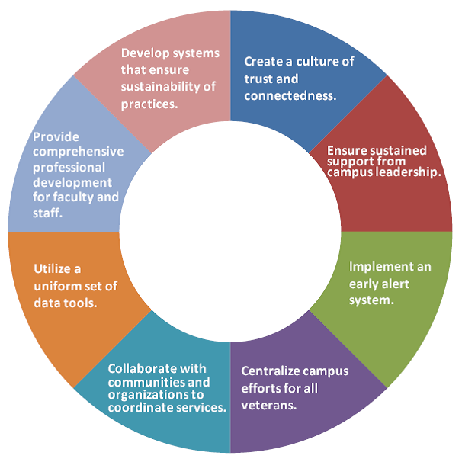
Supporting Student Veterans: Eight Keys
Source: “The Success of Veterans on America’s Campus: A Key Mission”
Notes:
VB

Slide 6
Key 1
Ensure sustained support from campus leadership
At ATC
Environmental scan
ATC/AWP leaders meet
Plans to expand support services
Notes:
VB

Slide 7
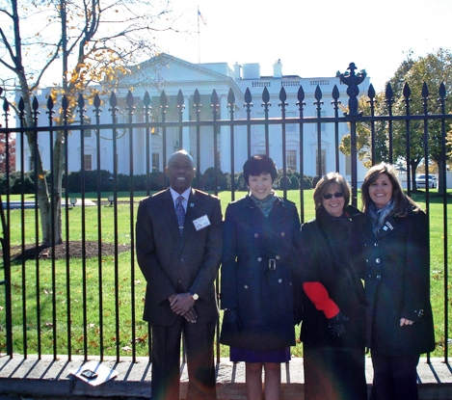
Key 2
Collaborate with communities and organizations to coordinate services
At ATC
AWP office on campus
Goodwill “Good Samaritan” program
Warriors 4 Wireless
Notes:
LM

Slide 8
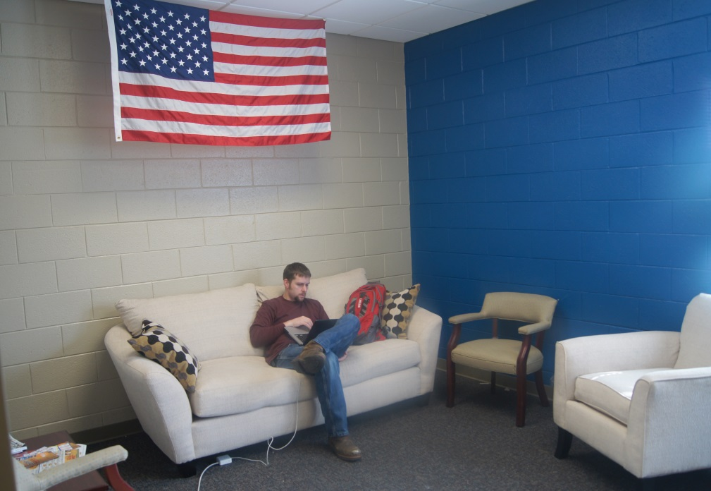
Key 3
Centralize campus efforts for all veterans
At ATC
Designated lounge space
Visibility on campus and online
Coordination of intake, funding, support
Notes:
RW

Slide 9
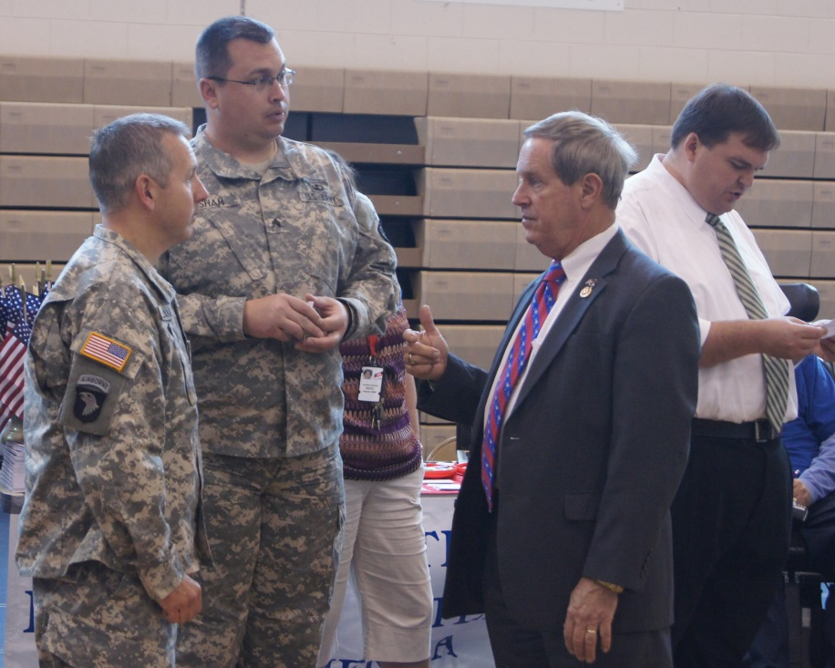
Key 4
Create a culture of trust and connectedness
At ATC
Military-friendly
Planning and update meetings
Collaboration on projects and media events
Notes:
VB

Slide 10
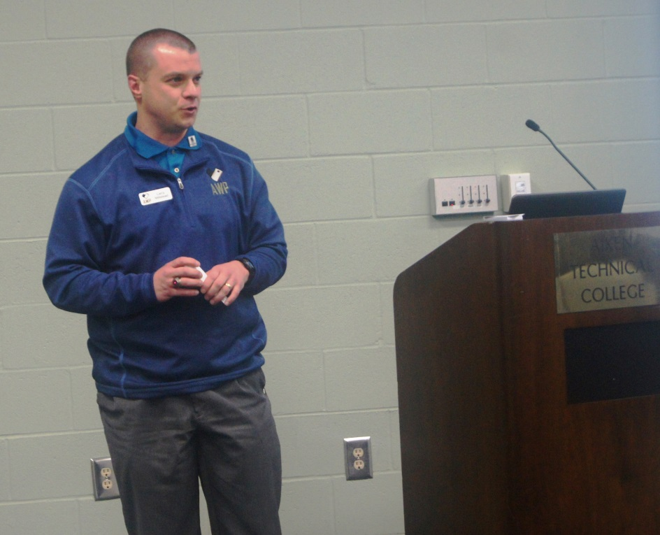
Key 5
Provide comprehensive professional development for faculty and staff
At ATC
AWP at faculty orientation
AWP at faculty/staff meetings
Notes:
LM

Slide 11
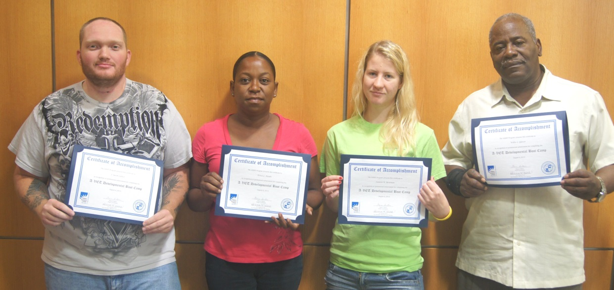
Key 6
Implement an early alert system
At ATC
Retention Alert
Counseling
AVET program
Student Veterans Association
www.studentveterans.org
Notes:
RW

Slide 12
Key 7
Utilize a uniform set of data tools
At ATC
Enrollment lists
Institutional data
AWP data tracking
Approximately 200 student veterans / military students are enrolled at ATC.
Notes:
VB

Slide 13
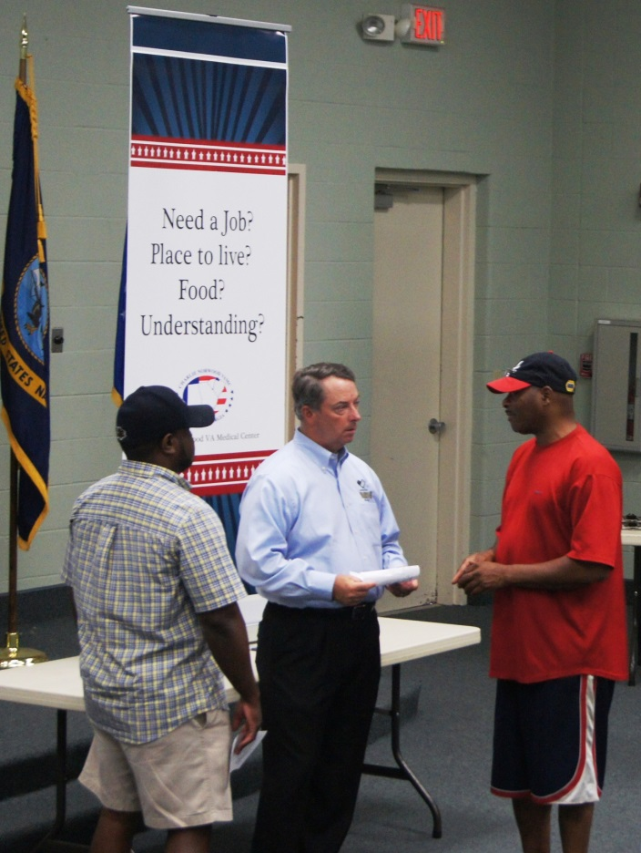
Key 8
Develop systems that ensure sustainability of practices
At ATC
Collaborative strategic planning (AWP/ATC)
Annual Plan inclusion
MOU development
Notes:
VB

Slide 14
Selected results
ATC
Student veteran recruitment and enrollment
New Tower Installation Certificate program
AWP
More visibility/outreach in CSRA via ATC
Achievement of organizational mission
Students
Camaraderie among student veterans on campus
Awareness of and use of resources
Notes:
RW: ATC
LM: AWP VB: Students

Slide 15
Neil Reed’s story
[Video clip regarding how Neil Reed attended ATC through help from AWP.]

Slide 16
Discussion

